Slide 1
Movie Tickets Price Prediction
By: Team Hercules

Slide 2
Contents
Introduction
Algorithm Used
Inputs
Results
Real Time Example
Future Addition to the Project
Conclusion

Slide 3
Introduction
The movie tickets price prediction is an AI based Machine Learning model for predicting the prices of movies on the basis of various factors like tickets sold, location, screen time, date and day of the month etc.
By forecasting the tickets price, screening in different locations can be optimized as well as effective market targeting and pricing.

Slide 4
Algorithm Used
The algorithm used in this model is the Random Forest Regression.
Random Forest a meta estimator that fits a number of classifying decision trees on various sub-samples of the dataset and uses averaging to improve the predictive accuracy and control over-fitting.

Slide 5
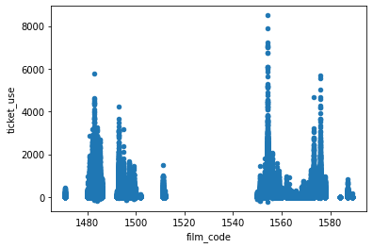
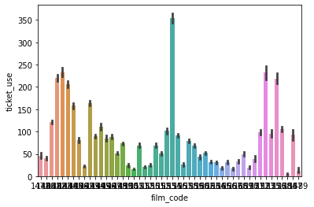
Inputs
The dataset was taken and read using pandas.
Different attributes of the dataset was plotted using pandas, seaborn and matplotlib.
Graph showing tickets used with respect to film code using pandas and seaborn

Slide 6

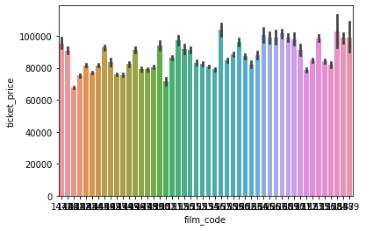
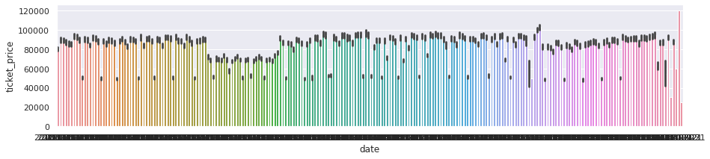

Slide 7
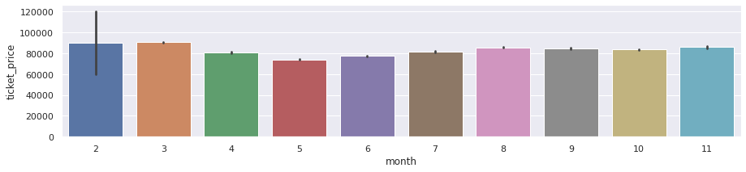
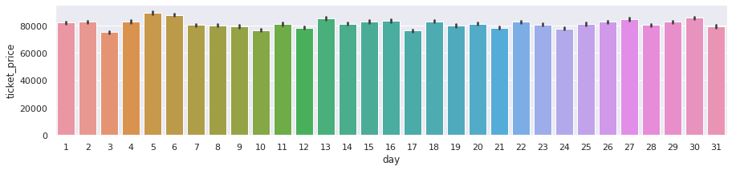

Slide 8
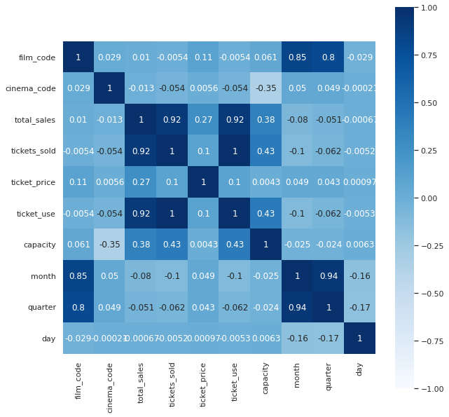
Correlation of the various parameters of the dataset

Slide 9
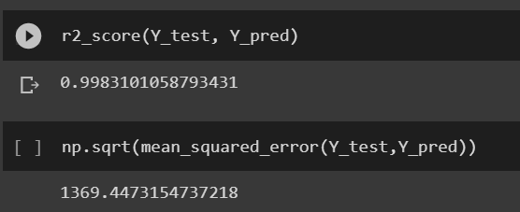
Results
The data was preprocessed for Model Training.
Result of the random forest regressor was obtained via the Root Mean Squared coefficient.

Slide 10
Real Time Example
Demand-based pricing is the highest form of price optimization. Tickets for movies change over time, based on the expected demand for each show and the number of tickets already sold.
This strategy is well-known in the airline and hospitality industry.​
All ticket booking apps whether it is PVR or BookMyShow uses this technique.

Slide 11
Future Addition To The Project
Web App
Mobile App Implementation
Prediction on basis of Movie Name.
Prediction on basis of Location

Slide 12
Conclusion
In this work we focused on developing a dynamic pricing model for movie-ticketing . We predicted the optimal demand price based on the data of total sales, ticket sold, date of show, capacity, etc.
The more data that is collected after instituting a dynamic pricing scheme, the better results can be achieved.

